Slide 1

Network+ Guide to Networks 6th Edition
Chapter 14
Ensuring Integrity and Availability

Slide 2
Objectives
Identify the characteristics of a network that keep data safe from loss or damage
Protect an enterprise-wide network from malware
Explain fault-tolerance techniques for storage, network design, connectivity devices, naming and addressing services, and servers
Discuss best practices for network backup and recovery
Describe the components of a useful disaster recovery plan and the options for disaster contingencies

Slide 3
What Are Integrity and Availability?
Integrity
Soundness of network’s programs, data, services, devices, connections
Availability
How consistently and reliably a file or system can be accessed
Uptime
Measure of time functioning normally between failures
Often expressed as percent uptime

Slide 4
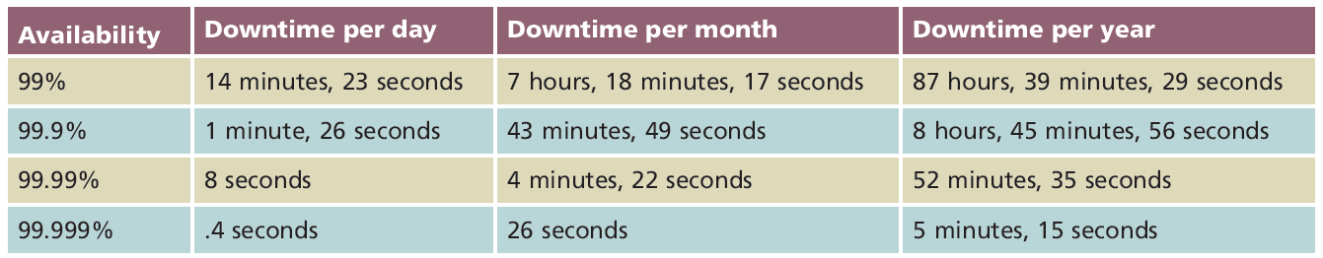
Table 14-1 Availability and downtime equivalents
Courtesy Course Technology/Cengage Learning

Slide 5
What Are Integrity and Availability? (cont’d.)
Integrity and availability compromised by:
Security breaches
Natural disasters
Malicious intruders
Power flaws
Human error
Follow guidelines to keep network highly available
See Pages 646-647 of text

Slide 6
Malware
Malicious software
Program designed to intrude upon or harm system, resources
Examples: viruses, Trojan horses, worms, bots
Virus
Replicating program intent to infect more computers
Copied to system without user knowledge
Replicates through network connections or exchange of external storage devices

Slide 7
Malware (cont’d.)
Trojan horse (Trojan)
Program that disguises itself as something useful
Actually harms your system

Slide 8
Malware Types and Characteristics
Malware categorized by location and propagation method
Boot sector viruses
Macro viruses
File-infector viruses
Worms
Trojan horses
Network viruses
Bots

Slide 9
Malware Types and Characteristics (cont’d.)
Malware characteristics
Encryption
Some viruses, worms, Trojan horses
Stealth
Hidden to prevent detection
Disguised as legitimate programs
Polymorphism
Change characteristics every time they transfer to new system
Use complicated algorithms; incorporate nonsensical commands

Slide 10
Malware Types and Characteristics (cont’d.)
Malware characteristics (cont’d.)
Time dependence
Programmed to activate on particular date
Can remain dormant and harmless until date arrives
Logic bombs: programs designed to start when certain conditions met
Malware can exhibit more than one characteristic

Slide 11
Malware Protection
Effective malware protection requires:
Choosing appropriate anti-malware program
Monitoring network
Continually updating anti-malware program
Educating users

Slide 12
Malware Protection (cont’d.)
Malware leaves evidence
Some detectable only by anti-malware software
User symptoms
Unexplained file size increases
Significant, unexplained system performance decline
Unusual error messages
Significant, unexpected system memory loss
Periodic, unexpected rebooting
Display quality fluctuations
Malware often discovered after damage done

Slide 13
Malware Protection (cont’d.)
Anti-malware key software functions
Signature scanning
Compares file’s content with known malware signatures
Integrity checking
Compares current file characteristics against archived version
Monitoring unexpected file changes
Receive regular updates from central network console
Consistently report valid instances of malware

Slide 14
Malware Protection (cont’d.)
Anti-malware software implementation
Dependent upon environment’s needs
Key: deciding where to install software
Desktop machines
Server
Balance protection with performance impact

Slide 15
Malware Protection (cont’d.)
Anti-malware policies
Rules for using anti-malware software
Rules for installing programs, sharing files, using external disks
Management should authorize and support policy
Anti-malware policy guidelines
See Pages 651-652 of text
Measures designed to protect network from damage, downtime

Slide 16
Fault Tolerance
Capacity for system to continue performing
Despite unexpected hardware, software malfunction
Failure
Deviation from specified system performance level
Given time period
Fault
Malfunction of one system component
Can result in failure
Fault-tolerant system goal
Prevent faults from progressing to failures

Slide 17
Fault Tolerance (cont’d.)
Degrees of fault tolerance
Optimal level depends on file or service criticality
Highest level
System remains unaffected by most drastic problem

Slide 18
Environment
Consider network device environment
Protect devices from:
Excessive heat, moisture
Use temperature, humidity monitors
Break-ins
Natural disasters

Slide 19
Power
Blackout
Complete power loss
Brownout
Temporary dimming of lights
Causes
Forces of nature
Utility company maintenance, construction
Solution
Alternate power sources

Slide 20
Power (cont’d.)
Power flaws not tolerated by networks
Types of power flaws that create damage
Surge
Momentary increase in voltage
Noise
Fluctuation in voltage levels
Brownout
Momentary voltage decrease
Blackout
Complete power loss

Slide 21
Power (cont’d.)
Uninterruptible power supplies (UPSs)
Battery-operated power source
Directly attached to one or more devices
Attached to a power supply
Prevents harm to device, service interruption
UPS categories
Standby
Online

Slide 22
Power (cont’d.)
Standby UPS (offline UPS)
Provides continuous voltage
Switches instantaneously to battery upon power loss
Restores power
Problems
Time to detect power loss
Device may have shut down or restarted

Slide 23
Power (cont’d.)
Online UPS
A/C power continuously charges battery
No momentary service loss risk
Handles noise, surges, sags
Before power reaches attached device
More expensive than standby UPSs
Factors to consider when choosing UPS
Amount of power needed
Period of time to keep device running
Line conditioning
Cost

Slide 24
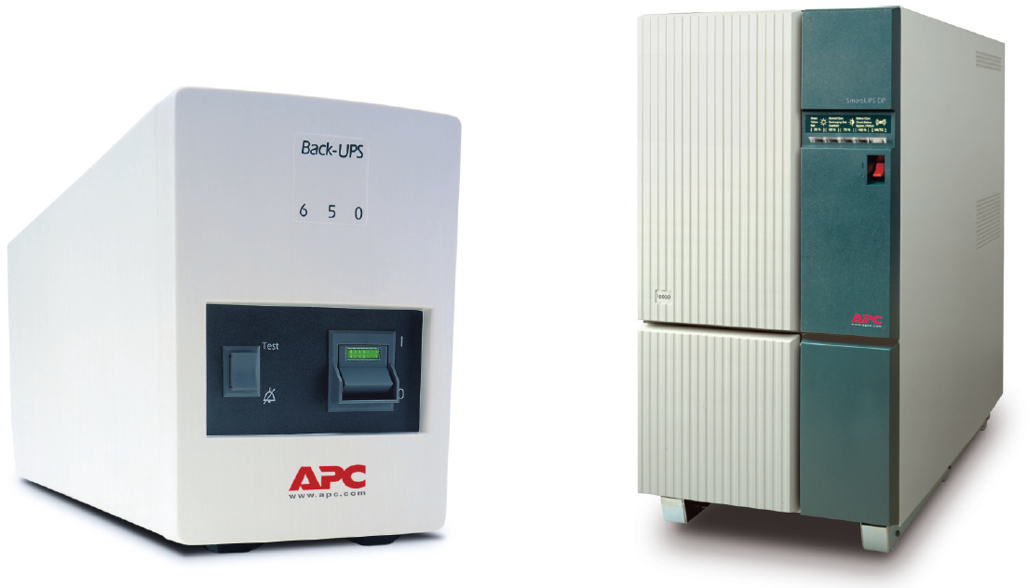
Figure 14-1 Standby and online UPSs
Courtesy of Schneider Electric

Slide 25
Power (cont’d.)
Generators
Powered by diesel, liquid propane, gas, natural gas, or steam
Do not provide surge protection
Provide electricity free from noise
Used in highly available environments
Generator choice
Calculate organization’s crucial electrical demands
Determine generator’s optimal size

Slide 26
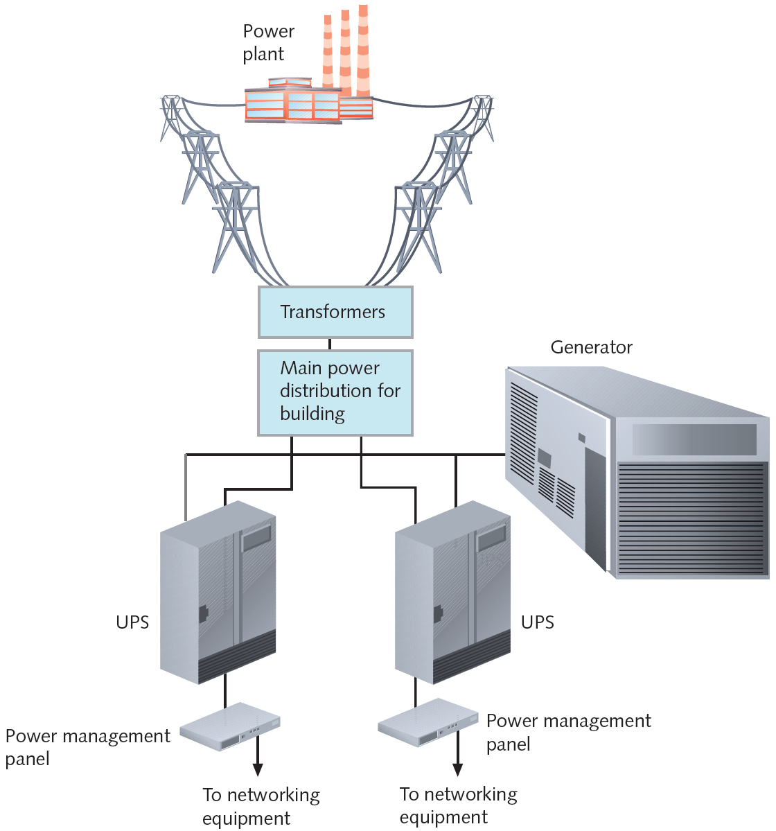
Figure 14-2 UPSs and a generator in a network design
Courtesy Course Technology/Cengage Learning

Slide 27
Network Design
Supply multiple paths for data travel
Topology
LAN: star topology and parallel backbone provide greatest fault tolerance
WAN: full-mesh topology
SONET technology
Uses two fiber rings for every connection
Can easily recover from fault in one of its links

Slide 28
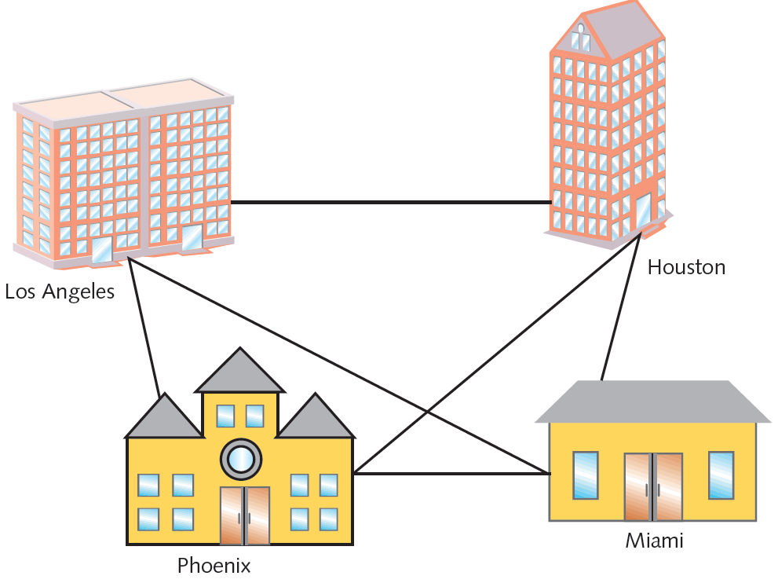
Figure 14-3 Full-mesh WAN
Courtesy Course Technology/Cengage Learning

Slide 29
Network Design (cont’d.)
Review PayNTime example on Pages 657-658
Possible solutions: supply duplicate connection
Use different service carriers
Use two different routes
Critical data transactions follow more than one path
Network redundancy advantages
Reduces network fault risk
Lost functionality, profits
Disadvantage: cost

Slide 30
Network Design (cont’d.)
Scenario: two critical links
Capacity, scalability concerns
Solution
Partner with ISP
Establish secure VPNs
See Figure 14-4

Slide 31
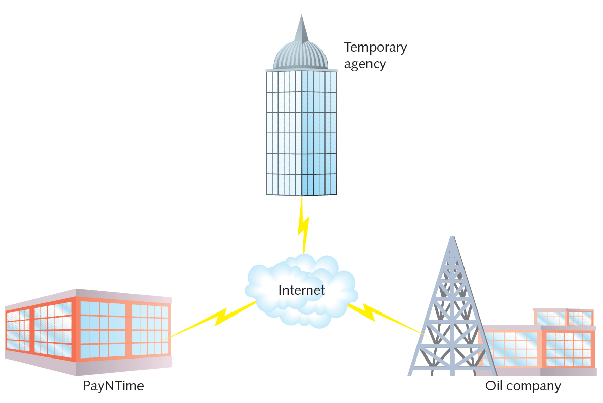
Figure 14-4 VPNs linking multiple customers
Courtesy Course Technology/Cengage Learning

Slide 32
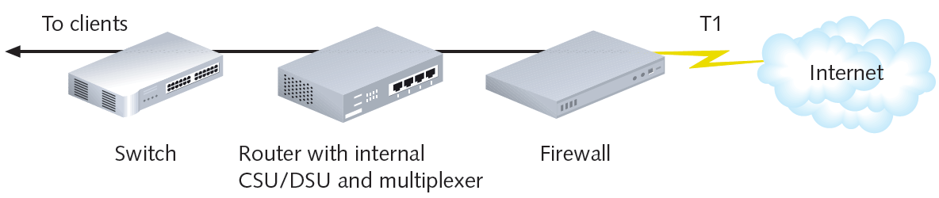
Network Design (cont’d.)
Scenario
Devices connect one LAN, WAN segment to another
Experience a fault
VPN agreement with national ISP
Single T1 link supports five customers
Figure 14-5 Single T1 connectivity
Courtesy Course Technology/Cengage Learning

Slide 33
Network Design (cont’d.)
Problem with arrangement of Figure 14-5
Many single points of failure
T1 link failure
Firewall, router, CSU/DSU, multiplexer, or switch
Solution
Redundant devices with automatic failover
Hot swappable devices
Immediately assume identical component duties
Cold spare
Duplicate device on hand, not installed

Slide 34
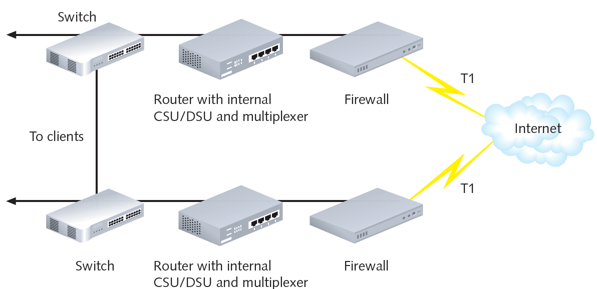
Figure 14-6 Fully redundant T1 connectivity
Courtesy Course Technology/Cengage Learning

Slide 35
Network Design (cont’d.)
Failover capable or hot swappable components
Desired for switches or routers supporting critical links
Adds to device cost
Link aggregation (bonding)
Combination of multiple network interfaces to act as one logical interface
Example: NIC teaming
Load balancing
Automatic traffic distribution over multiple components or links

Slide 36
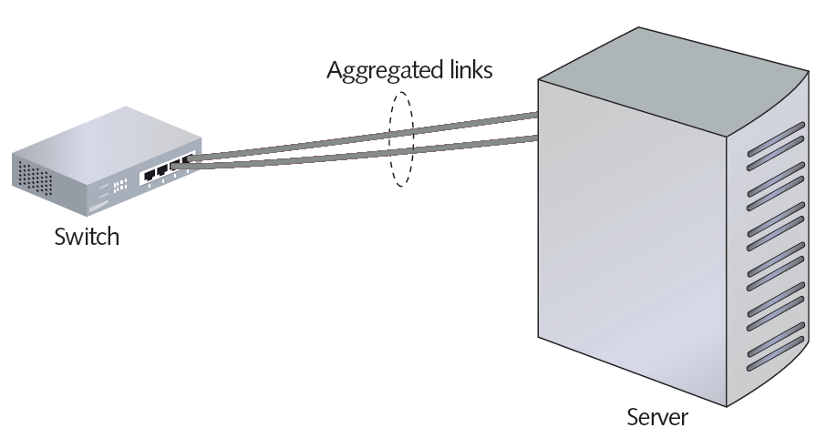
Figure 14-7 Link aggregation between a switch and server
Courtesy Course Technology/Cengage Learning

Slide 37
Network Design (cont’d.)
Naming and addressing services
Failure causes nearly all traffic to come to a halt
Solution: maintain redundant name servers
DNS caching servers
Allows local name resolution
Faster performance
Reduces burden on master name server

Slide 38
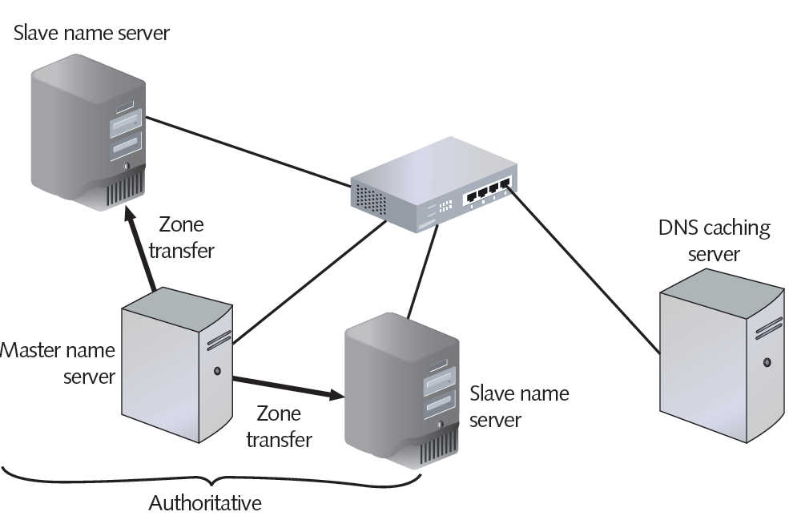
Figure 14-8 Redundant name servers
Courtesy Course Technology/Cengage Learning

Slide 39
Network Design (cont’d.)
DNS can point to redundant locations for each host name
Use different IP addresses that all point to identical Web servers
Round-robin DNS
Use each IP address sequentially
Load balancer
Dedicated device for intelligent traffic distribution
Considers traffic levels when forwarding requests

Slide 40
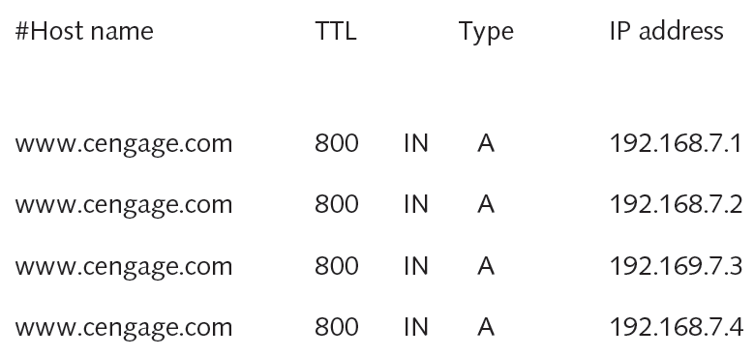
Figure 14-9 Redundant entries in a DNS zone file
Courtesy Course Technology/Cengage Learning

Slide 41
Network Design (cont’d.)
CARP (Common Address Redundancy Protocol)
Allows pool of computers to share IP addresses
Master computer receives request
Parcels out request to one of several group computers

Slide 42
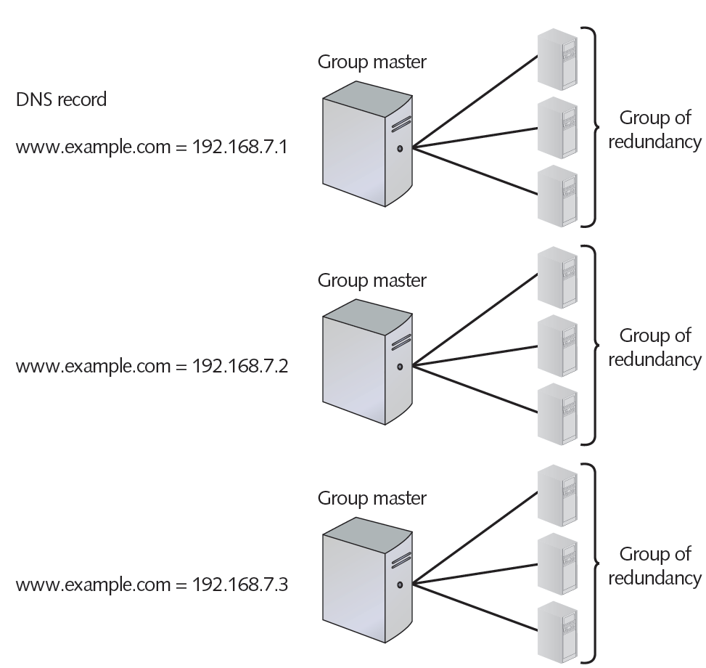
Figure 14-10 Round-robin DNS with CARP
Courtesy Course Technology/Cengage Learning

Slide 43
Servers
Critical servers
Contain redundant components
Provide fault tolerance, load balancing
Server mirroring
Fault-tolerance technique
One device, component duplicates another's activities
Uses identical servers, components
High-speed link between servers
Synchronization software
Form of replication
Dynamic copying of data from one location to another

Slide 44
Servers (cont’d.)
Server mirroring advantage
Flexibility in server location
Disadvantages
Time delay for mirrored server to assume functionality
Toll on network as data copied between sites
Hardware and software costs
May be justifiable

Slide 45
Servers (cont’d.)
Clustering
Links multiple servers together
Act as single server
Clustered servers share processing duties
Appear as single server to users
Failure of one server
Others take over
More cost-effective than mirroring
For large networks

Slide 46
Servers (cont’d.)
Clustering advantages over mirroring
Each clustered server
Performs data processing
Always ready to take over
Reduces ownership costs
Improves performance

Slide 47
Storage
Data storage
Issues of availability and fault tolerance apply
Various methods available
Ensure shared data and applications never lost or irretrievable
RAID (Redundant Array of Independent [or Inexpensive] Disks)
Collection of disks
Provide shared data, application fault tolerance

Slide 48
Storage (cont’d.)
Disk array (drive)
Group of hard disks
RAID drive (RAID array)
Collection of disks working in a RAID configuration
Single logical drive

Slide 49
Storage (cont’d.)
Hardware RAID
Set of disks, separate disk controller
RAID array managed exclusively by RAID disk controller
Attached to server through server’s controller interface
Software RAID
Software implements and controls RAID techniques
Any hard disk type
Less expensive (no controller, disk array)
Performance rivals hardware RAID
Several different types of RAID available

Slide 50
Storage (cont’d.)
NAS (Network Attached Storage)
Specialized storage device, storage device group
Provides centralized fault-tolerant data storage
Difference from RAID
Maintains own interface to LAN
Advantages
NAS device contains own file system
Optimized for saving, serving files
Easily expandable
No service interruption

Slide 51
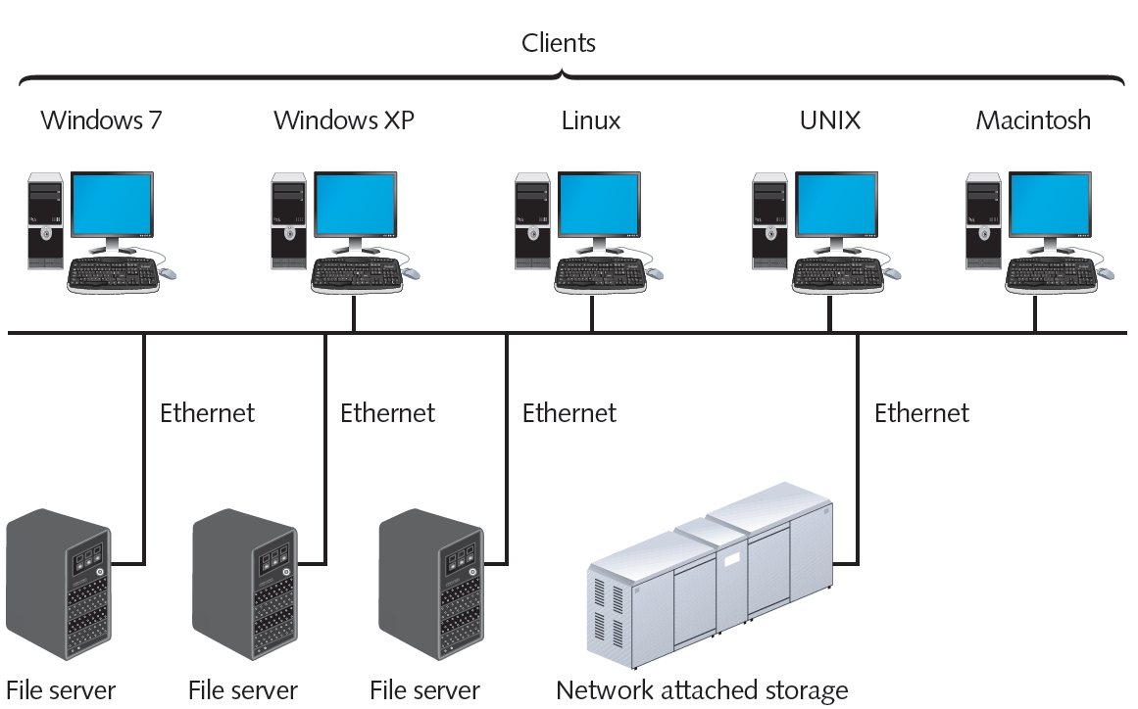
Figure 14-11 Network attached storage on a LAN
Courtesy Course Technology/Cengage Learning

Slide 52
Storage (cont’d.)
Disadvantage
No direct communication with network clients
NAS use
Enterprises requiring fault tolerance, fast data access
SANs (Storage Area Networks)
Distinct networks of storage devices
Communicate directly with each other, other networks
Typical SAN contains multiple storage devices
Connected to multiple, identical servers

Slide 53
Storage (cont’d.)
SAN advantages
Fault tolerant
Extremely fast
Special transmission method
Fiber-optic media, proprietary protocols
Example: Fibre Channel
Install in location separate from LAN served
Provides added fault tolerance
Highly scalable
Faster, more efficient method of writing data

Slide 54
Storage (cont’d.)
SAN disadvantages
High cost
Small SAN: $100,000
Large SAN: several million dollars
More complex than NAS, RAID
Training, administration efforts required
Use
Environments with huge data quantities requiring quick availability

Slide 55
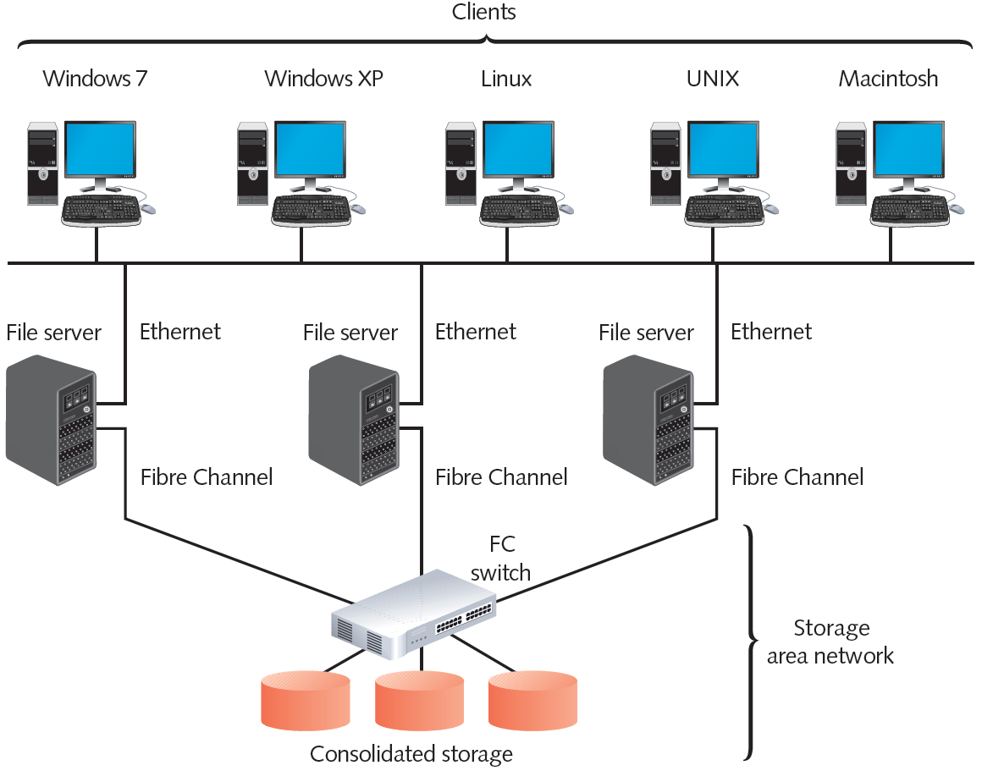
Figure 14-12 A storage area network
Courtesy Course Technology/Cengage Learning

Slide 56
Data Backup
Backup
Copies of data or program files
Created for archiving, safekeeping
Store off site
Without backup: risk losing everything
Many backup options available
Performed by different software and hardware
Use different storage media types
Can be controlled by NOS utilities, third-party software

Slide 57
Backup Media and Methods
Approach to selecting backup media, methods
Ask questions to select appropriate solution
Optical media
Media storing digitized data
Uses laser to write data, read data
Examples: CDs, DVDs
Backup requirements
Recordable CD or DVD drive, software utility
Blu-ray
Optical storage format

Slide 58
Backup Media and Methods (cont’d.)
DVD and Blu-ray DVD disadvantages
Writing data takes longer than other media
Requires more human intervention than other backup methods
Tape backups
Copying data to magnetic tape
Requirements
Tape drive connected to network
Management software
Backup media

Slide 59
Backup Media and Methods (cont’d.)
Small network tape backups
Stand-alone tape drives attached to each server
Large network tape backups
One large, centralized tape backup device
Manages all subsystems’ backups
Extremely large environments
Robots retrieve, circulate tapes from tape storage library

Slide 60
Backup Media and Methods (cont’d.)
External disk drives (removable disk drives)
Storage device attached temporarily to computer
USB, PCMCIA, FireWire, CompactFlash port
Simple to use, save, share data
Temporary drive appears like any other drive
Large data amount requirements
Backup control features, higher storage capacity, faster read-write access

Slide 61
Backup Media and Methods (cont’d.)
Network backups
Save data to another place on network
Different server, another WAN location
SAN, NAS storage device
Online backup (cloud backup)
Saves data to another company’s storage array using Internet
Implement strict security measures
Automated backup, restoration processes
Evaluate online back up provider
Test speed, accuracy, security, recovery

Slide 62
Backup Strategy
Devise a strategy to perform reliable backups
Document in accessible area
Address various questions
Archive bit
File attribute
Set to on or off
On indicates file must be archived
Used by various backup methods

Slide 63
Backup Strategy (cont’d.)
Full backup
All data copied
Uncheck archive bits
Incremental backup
Copy data changed since last full, incremental backup
Uncheck archive bits
Differential backup
Copy only data changed since last backup
All data marked for subsequent backup
Does not uncheck archive bits

Slide 64
Backup Strategy (cont’d.)
Determine best backup rotation scheme
Plan specifies when and how often backups occur
Goal
Provide excellent data reliability without overtaxing network, requiring intervention
Grandfather-Father-Son strategy
Uses backup sets
Daily (son)
Weekly (father)
Monthly (grandfather)

Slide 65
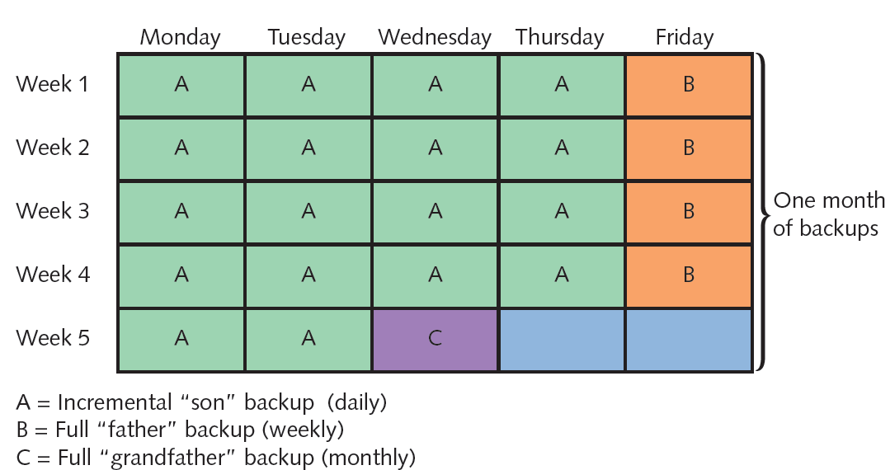
Figure 14-13 The Grandfather-Father-Son backup rotation scheme
Courtesy Course Technology/Cengage Learning

Slide 66
Backup Strategy (cont’d.)
Ensure backup activity recorded in backup log
Backup date
Media identification
Type of data backed up
Type of backup
Files backed up
Backup location
Establish regular verification schedule
Attempt to recover files periodically

Slide 67
Disaster Recovery
Disaster recovery
Restoring critical functionality, data
After enterprise-wide outage
Affecting more than single system, limited group
Consider possible extremes
Not relatively minor outages, failures, security breaches, data corruption

Slide 68
Disaster Recovery Planning
Account for worst-case scenarios
Identify disaster recovery team
Provide contingency plans
Restore and replace:
Computer systems
Power
Telephony systems
Paper-based files
Plan contains various sections
Lessen critical data loss risk

Slide 69
Disaster Recovery Contingencies
Cold site
Components necessary to rebuild network exist
Not appropriately configured, updated, or connected
Warm site
Components necessary to rebuild network exist
Some appropriately configured, updated, and connected
Hot site
Components exist and match network’s current state
All appropriately configured, updated, and connected

Slide 70
Summary
Integrity and availability: important concepts
Malware aims to intrude upon or harm system
Anti-malware software part of network protection
Fault tolerance allows system to continue performing despite unexpected malfunction
Various types of backup power supplies exist
Network design can provide different levels of fault tolerance
Mirroring, clustering, RAID, NAS, and SAN can provide fault tolerance

